Slide 1
Restaurant COMPLETION AND EXPANSION Plan

Slide 2
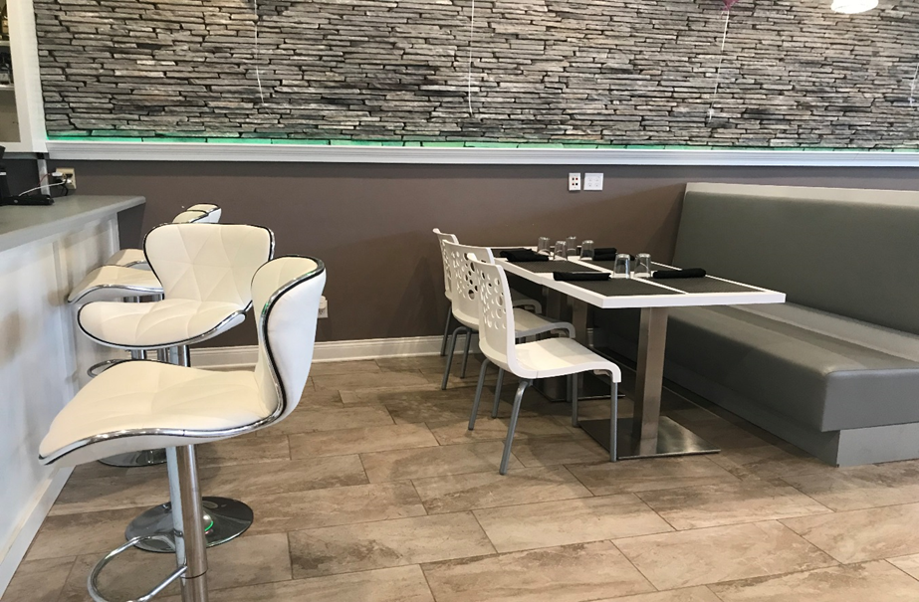
Introduction
The restaurant project successfully completed its initial development.
It was ready for further expansion.
The restaurant needed new staff members after the process of expansion.
There was the need for the incorporation of technology in the activities the operations of the restaurant.
There was need to integrate the website with elements of the web 2.0 (Facebook, twitter ,WhatsApp)to capture the millennial population.

Slide 3
LITRATURE REVIEW
The financial challenges were still apparent even after completion and would be a hurdle in expansion process.
The physical expansion of every business usually attracts other costs such as the cost of hiring human resource
Sometimes when a restaurant is expanding the need for the integration of the in formation technology infrastructure comes in
Automation of operations is an important part of scaling up
There might be the need to retrain the old staffs so that they can acquire new techniques to help them in new environment

Slide 4
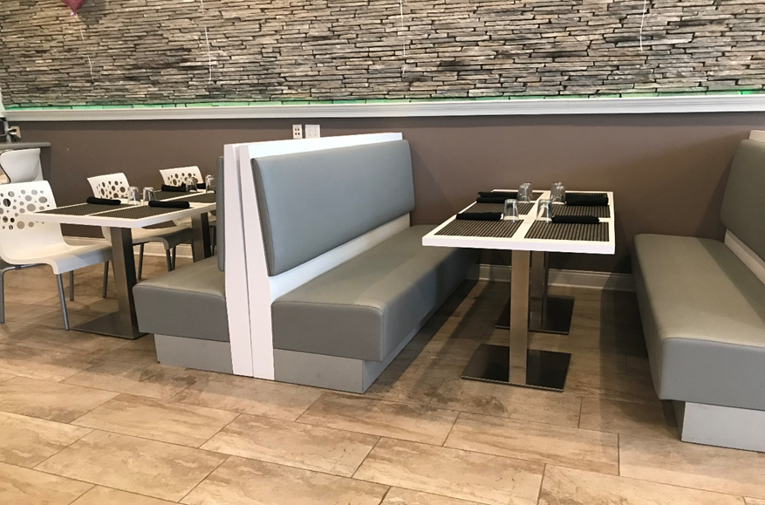
Research Methodology
The research will be unstructured research
The research will be a survey
The research will be expected to adopt the cases study design
The target group for the research is the clients, the similar business owners have successfully passed the expansion stage
The study will have 18 respondents mainly 10 customers,4 restaurant owners and 4 employees

Slide 5
Research Methodology
The research will use the face to face interview
The reason for the use of interview will allow the researcher to seek clarifications
The primary data will be collected through the face to face interviews
The researcher will constructs questionnaires with the open ended questions
Secondary data will be obtained from the publish government and articles that address the challenges of growth in the hotel sector

Slide 6
Research Findings
Expansion was important if it was beneficial for the clients
Clients needed expansion in order to get space to conduct meeting
They needed the hotel to have information technology infrastructure to include even payment
The employee needed to be retrained in order to serve better
The employees welfare also had to be checked when it came to salary and other remunerations

Slide 7
Research Findings
Managers asserted that automation was integral part of management
The employees saw automation to have the ability of reducing their work
The customers wanted automation to enable them to make orders online
The millennials represented the huge number that supported automation.
The integration of social media into the information technology infrastructure was supposed to act as a gate way to get more clients

Slide 8
Research findings
The table showing the platforms expected in social media infrastructure
Facebook | Social networking site connecting family, friends and acquaintances
Linked In | Social networking site primarily used by business professionals
My space | One of the original social networking sites. Primarily used for friend to friend communications
Twitter | One of the newest iterations of social networking. Helps the “tweeters” keep track of what everyone is doing in real time.
Blogger | Blogs were launched in 1999 (blogger.com) and create a forum for individuals to speak and report anything on their minds
You tube | One of the most popular social media sites, where individuals upload and share video clip

Slide 9
Research Findings
Capital investment was seen to be a major issue that affects the process of expansion in any hotel
The restaurant location was found to be significant.such that crowded areas attracts more people than secluded areas
Organizational culture was found to be a very integral such that restaurants with strong organization culture had chances of development
There was need to develop a strong organizational culture

Slide 10
Research Findings
There was need to develop organization culture during expansion
The restaurant had to develop a very interactive social media platform to make sure that they attract more clients
The restaurant had to develop a very strong social commerce platform that had many interactive platforms.
Expansion of human resource was deemed as necessary for the process of scaling up

Slide 11
Conclusion
The project turned out to be success in completing its initial development.
The loyalty of most of the customers increased tremendously
The employees grievances were dealt with effectively by increasing their allowances and benefit
The automation of the company made the work easier for the employees and the clients
There was overwhelming change in sales which increased the number of people coming to the restaurant

Slide 12
References
Kamel, S. (2003). Managing globally with information technology. Hershey, Pa: IRM Pres
Harnish, V., & Gazelles Inc.,. (2014). Scaling up: How a few companies make it... and why the rest don't.
Davidsson, P., Achtenhagen, L., & Naldi, L. (2010). Small firm growth. Boston: Now.
In Kuriakose, S. (2013). Fostering Entrepreneurship in Azerbaijan.
Giousmpasoglou, C. (2016). Restaurant and restaurant management education.
O’Neill, J. W., & Mattila, A. S. (2006). Strategic restaurant development and positioning: The effects of revenue drivers on profitability. Cornell Restaurant and Restaurant Administration Quarterly, 47(2), 146-154.
Upneja, A., & Dalbor, M. C. (2001). An examination of capital structure in the restaurant industry. International Journal of Contemporary Hospitality Management, 13(2), 54-59.
O’Neill, J. W., & Mattila, A. S. (2006). Strategic restaurant development and positioning: The effects of revenue drivers on profitability. Cornell Restaurant and Restaurant Administration Quarterly, 47(2), 146-154.

